Slide 1
BREAK STATEMENT
When the break statement is encountered inside a loop, the loop is immediately terminated and the program control resumes at the next statement following the loop.
It can be used to terminate a case in the switch statement.
Syntax: Break;

Slide 2
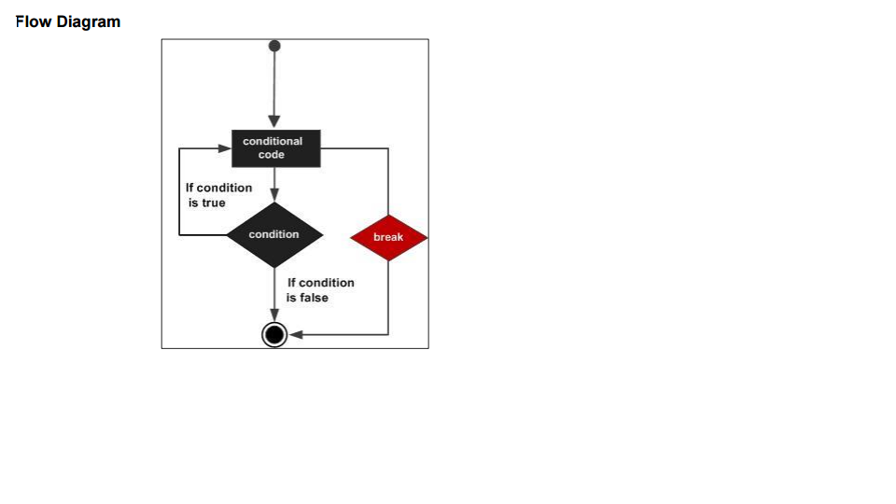

Slide 3
public class BreakExample {
public static void main(String[] args)
{
for(int i=1;i<=10;i++){
if(i==5){
break;
}
System.out.println(i);
}
}
}

Slide 4
CONTINUE Statement
The continue keyword can be used in any of the loop control structures. It causes the loop to immediately jump to the next iteration of the loop.
In a for loop, the continue keyword causes control to immediately jump to the update statement.
In a while loop or do/while loop, control immediately jumps to the Boolean expression.
Syntax : continue;

Slide 5
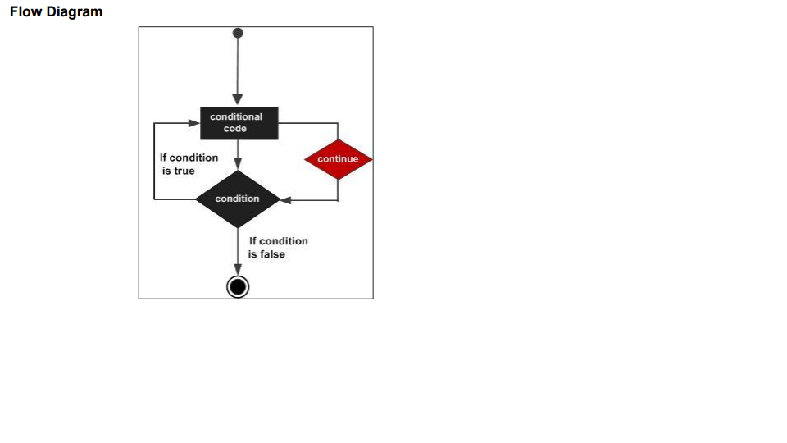

Slide 6
public class Continue{
public static void main(String[] args)
{
System.out.println("From the for loop");
for(int a=0;a<=10;a++)
{
if(a==5)
{
continue;
}
System.out.println(a+"loop");
}
System.out.println("from the while loop");
int b=1;
while(b<=10)
{
if(b==5)
{
b++;
continue;
}
System.out.println(b+"loop");
b++;
}
}
}

